Slide 1
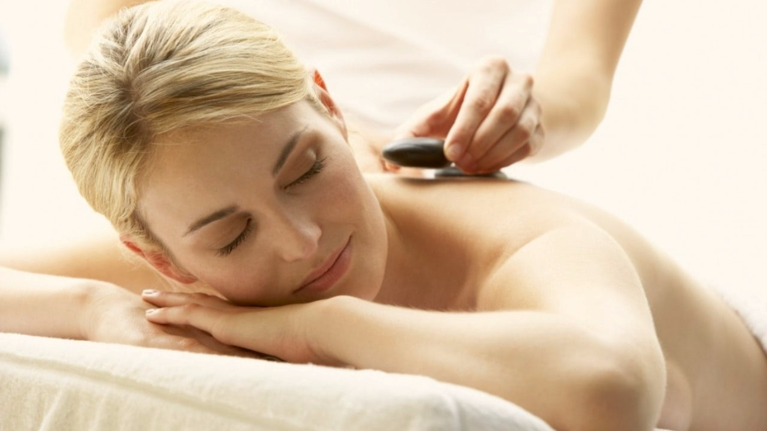

Home
Pricing
Book now
About us
Contacts
New user
Join us
Login
User Login
New therapist
Relax. Rejuvenate. Renew.
Discover the healing power of touch. Our expert massage therapies not only melt away stress but also improve circulation, relieve muscle tension, and promote overall well-being.
Invest in your health—because you deserve it.
Find your closest therapist

Slide 2




Home
Bookings
About us
Services
Contacts
Profile
Join us
Sign in
Germany Mobile Spa
Email address* / Phone number*
Password*
Sign up with Google
Forgot password?
Remember me
Sign up with Facebook
Login

Slide 3
Home
Bookings
About us
Services
Contacts
Profile
Join us
Sign in
Germany Mobile Spa
XXXXXXXXXXXXX@gmail.com
***************
Sign up with Google
Forgot password?
Remember me
Sign up with Facebook
Login

Slide 4

Home
Bookings
About us
Services
Contacts
Profile
Join us
Sign in
Germany Mobile Spa
XXXXXXXXXXXXX@gmail.com
egg24@#e2grq!@Rf
Sign up with Google
Forgot password?
Remember me
Sign up with Facebook
Login

Slide 5
Home
Bookings
About us
Services
Contacts
Profile
Join us
Sign in
Germany Mobile Spa
Logging in…

Slide 6
Home
Bookings
About us
Services
Contacts
Profile
Sign out
Germany Mobile Spa
Relax. Rejuvenate. Renew.
Discover the healing power of touch. Our expert massage therapies not only melt away stress but also improve circulation, relieve muscle tension, and promote overall well-being. Invest in your health —because you deserve it.
(we were automatically signed in)
Find your closest therapist

Slide 7
Therapist Login

Slide 8
Home
Bookings
About us
Services
Contacts
Profile
Join us
Sign in
Germany Mobile Spa
Email address* / Phone number*
Password*
Sign up with Google
Forgot password?
Remember me
Sign up with Facebook
Login

Slide 9
Home
Bookings
About us
Services
Contacts
Profile
Join us
Sign in
Germany Mobile Spa
XXXXXXXXXXXXX@gmail.com
***************
Sign up with Google
Forgot password?
Remember me
Sign up with Facebook
Login

Slide 10
Home
Bookings
About us
Services
Contacts
Profile
Join us
Sign in
Germany Mobile Spa
Logging in…

Slide 11
Notifications
Contacts
Profile
Home
Schedule
About us
Contacts
Profile
Join us
Home
Bookings
About us
Services
Services
Sign out
Sign in
Germany Mobile Spa
Germany Mobile Spa
Relax. Rejuvenate. Renew.
Discover the healing power of touch. Our expert massage therapies not only melt away stress but also improve circulation, relieve muscle tension, and promote overall well-being. Invest in your health —because you deserve it.
(we were automatically signed in notice there are no options to look for therapists)

Slide 12
Home
Pricing
Book now
About us
Contacts
New user
Join us
Login
User Login with Facebook/Google
New therapist
Relax. Rejuvenate. Renew.
Discover the healing power of touch. Our expert massage therapies not only melt away stress but also improve circulation, relieve muscle tension, and promote overall well-being.
Invest in your health—because you deserve it.
Find your closest therapist

Slide 13
Home
Bookings
About us
Services
Contacts
Profile
Join us
Sign in
Germany Mobile Spa
Email address* / Phone number*
Password*
Sign up with Google
Forgot password?
Remember me
Sign up with Facebook
Login

Slide 14
Home
Bookings
About us
Services
Contacts
Profile
Join us
Sign in
Germany Mobile Spa
Email address* / Phone number*
Password*
Sign up with Google
Forgot password?
Remember me
Sign up with Facebook
Login

Slide 15
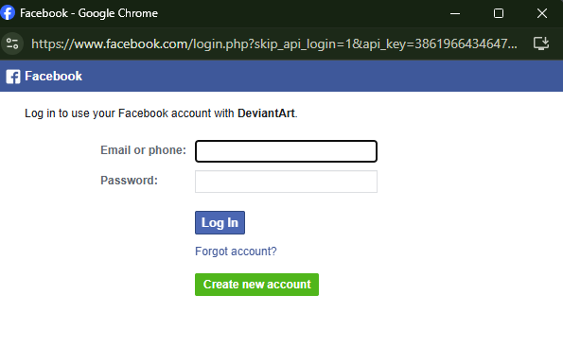
Home
Bookings
About us
Services
Contacts
Profile
Join us
Sign in
Germany Mobile Spa
Email address* / Phone number*
Password*
Sign up with Google
Forgot password?
Remember me
Sign up with Facebook
Login

Slide 16
Home
Bookings
About us
Services
Contacts
Profile
Join us
Sign in
Germany Mobile Spa
Email address* / Phone number*
ricardo@gmail.com
57357864584578467
Password*
Sign up with Google
Forgot password?
Remember me
Sign up with Facebook
Login

Slide 17
Home
Bookings
About us
Services
Contacts
Profile
Sign out
Germany Mobile Spa
Relax. Rejuvenate. Renew.
Discover the healing power of touch. Our expert massage therapies not only melt away stress but also improve circulation, relieve muscle tension, and promote overall well-being. Invest in your health —because you deserve it.
(we were automatically signed in)
Find your closest therapist

Slide 18
Therapist Login with Facebook/Google

Slide 19
Home
Bookings
About us
Services
Contacts
Profile
Join us
Sign in
Germany Mobile Spa
Email address* / Phone number*
Password*
Sign up with Google
Forgot password?
Remember me
Sign up with Facebook
Login

Slide 20
Home
Bookings
About us
Services
Contacts
Profile
Join us
Sign in
Germany Mobile Spa
Email address* / Phone number*
Password*
Sign up with Google
Forgot password?
Remember me
Sign up with Facebook
Login

Slide 21
Home
Bookings
About us
Services
Contacts
Profile
Join us
Sign in
Germany Mobile Spa
Email address* / Phone number*
Password*
Sign up with Google
Forgot password?
Remember me
Sign up with Facebook
Login

Slide 22
Home
Bookings
About us
Services
Contacts
Profile
Join us
Sign in
Germany Mobile Spa
Email address* / Phone number*
ricardo@gmail.com
57357864584578467
Password*
Sign up with Google
Forgot password?
Remember me
Sign up with Facebook
Login

Slide 23
Notifications
Contacts
Profile
Home
Schedule
About us
Contacts
Profile
Join us
Home
Bookings
About us
Services
Services
Sign out
Sign in
Germany Mobile Spa
Germany Mobile Spa
Relax. Rejuvenate. Renew.
Discover the healing power of touch. Our expert massage therapies not only melt away stress but also improve circulation, relieve muscle tension, and promote overall well-being. Invest in your health —because you deserve it.
(we were automatically signed in notice there are no options to look for therapists)

